Slide 1

Leveraging AI tools to amplify club impact
PP Hamish Jones
Rotary Club of Strathmore

Slide 2
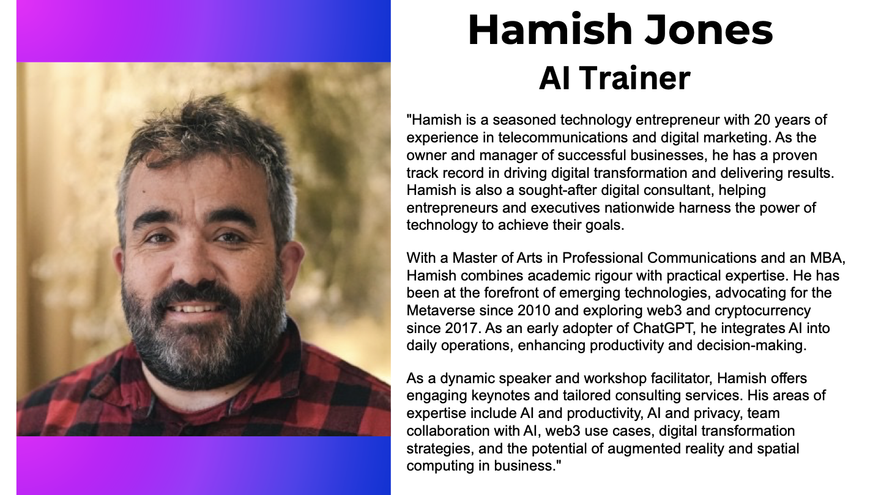

Slide 3
Why AI? Why Now?
Rotary’s motto: Service Above Self
The challenge: Time & resource constraints
The solution: Leveraging AI to amplify efforts

Slide 4
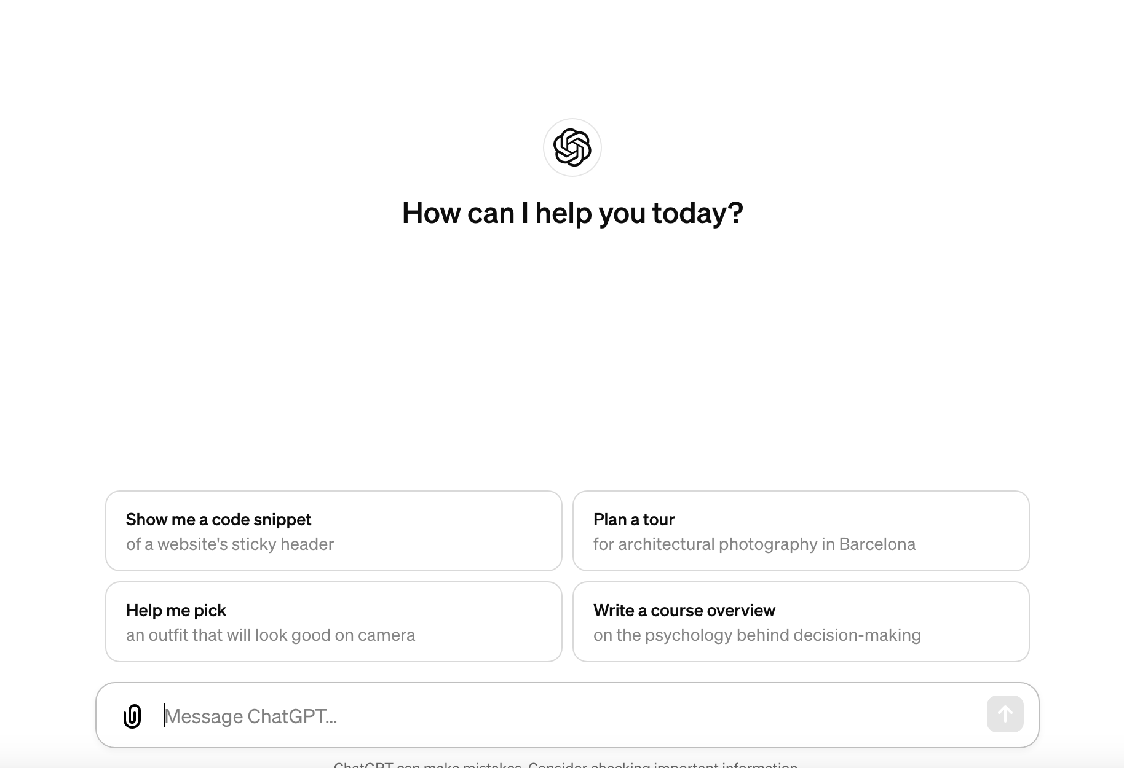
What is ChatGPT?
Conversational AI Language Model
Created by OpenAI
Free Service and Paid Options
Upgrade for higher speeds, and later models
AI can help
Create effective solutions
Make informed choices
Provide impactful content
And so much more
Launched Nov 30, 2022
Trained on Data through to December 2023

Slide 5

ChatGPT Alternatives
Google Gemini
Claude
Perplexity AI
NotebookLM
Other ways to use GPT4
Bing
Microsoft Copilot

Slide 6
The Past – Traditional Club Operations
Manual admin tasks: Meeting notes, emails, follow-ups
Limited outreach and impact
Traditional communication methods

Slide 7
The Present – How AI Tools Like ChatGPT Are Changing the Game
Automating repetitive tasks
Enhancing personalization in member communication
AI for content creation and engagement

Slide 8

Automating Repetitive Tasks
Email Campaign Prompt:
“Write a welcoming email for a new Rotary member, outlining the club’s mission, next meeting details, and how they can get involved in community service.”
Meeting Minutes Prompt:
“Summarize key points from this recording of our Rotary meeting where the club discussed fundraising ideas for a community project.”

Slide 9
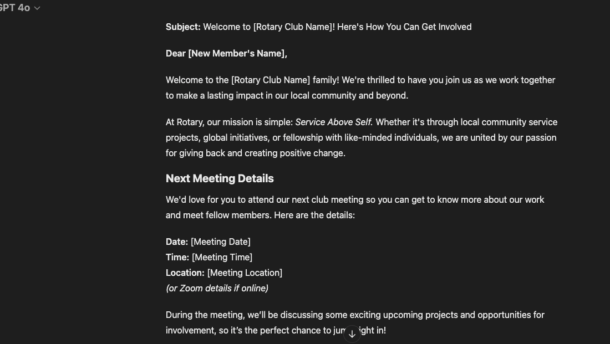

Slide 10
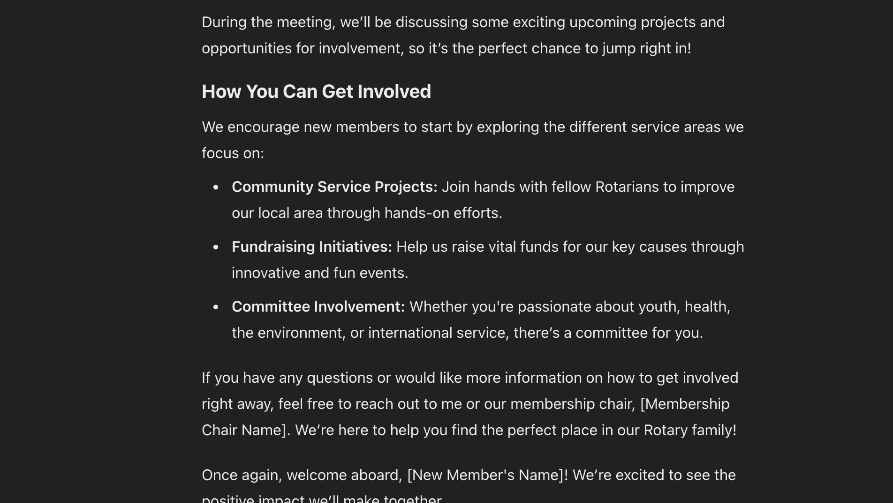

Slide 11
Enhancing Personalization in Member Communication
• Personalized Email Prompt:
“Create a personalized follow-up email to a Rotary volunteer who participated in last month’s event, thanking them and providing upcoming volunteer opportunities.”

Slide 12
AI for Content Creation
• Social Media Prompt:
“Write a short social media post for Facebook encouraging community members to join our Rotary event aimed at cleaning up the local park. Include details about how to get involved.”

Slide 13
Real Examples of AI at Work
Automated email campaigns with ChatGPT
Social media posts tailored to your community
Streamlined meeting notes and follow-ups

Slide 14
The Future – AI-Powered Growth
AI for member growth and retention
Data-driven insights for community projects
Predictive tools for project impact

Slide 15
Potential AI Use Cases
Event Planning and Management
Community Outreach
Internal Communication & Admin
Training & Development
Fundraising Efforts
Digital Transformation
Community Impact Reports
Strategic Planning
Enhancing Inclusivity & Diversity

Slide 16
The Power of Small Steps
Start with one task: Automate emails or meeting minutes
Scale gradually as comfort with AI grows
AI tools are accessible, no expertise required

Slide 17
What’s possible for Rotary Club Improvement
Chatbots to engage potential members
AI-powered surveys for community feedback
Partnerships with local businesses using AI

Slide 18
Key Takeaways & Action Steps
AI is an enabler, not a replacement
Start small, experiment, and scale
Focus on impact, not the tool

Slide 19

Ready to jump in & want more support?

