Slide 1

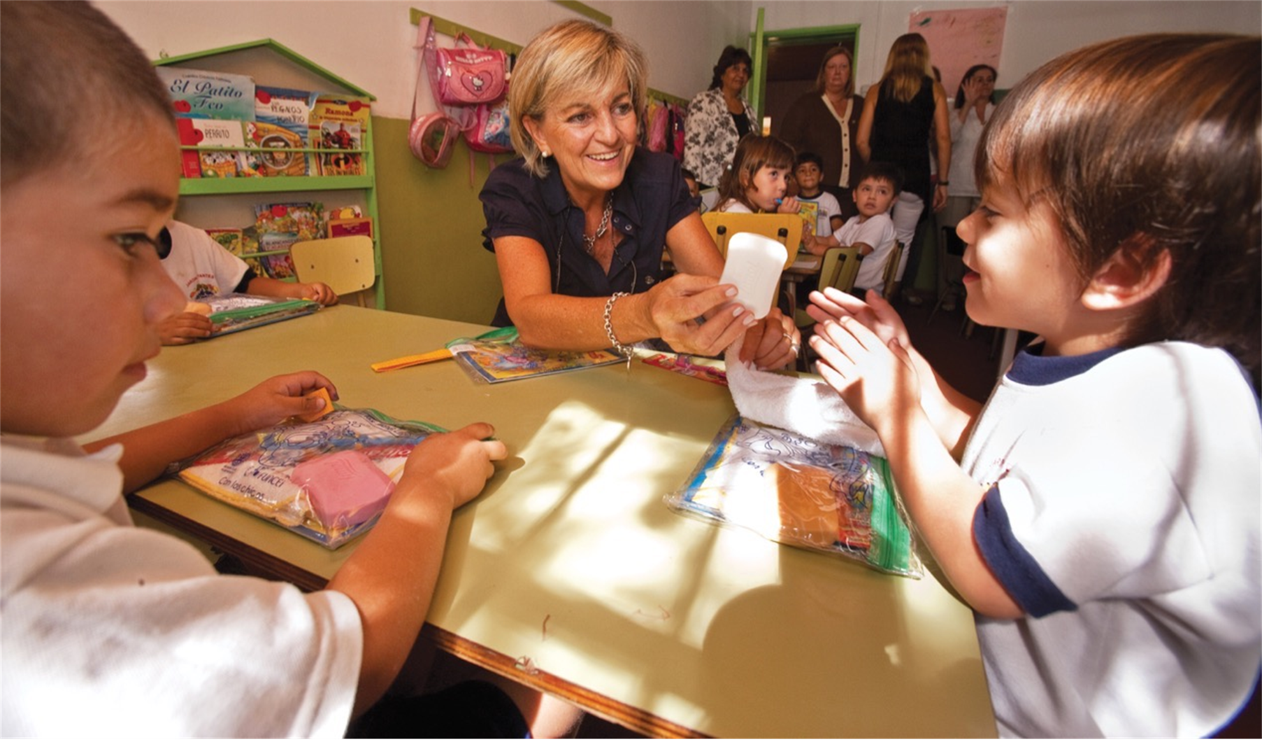
Value Proposition and Public Image

Slide 2

Background
Regional Council Director
Past President Rotary Club of Wahroonga
60 Members, 50% Women – Looks great from the outside but in a precarious position
Recently took my Club through a Strategic Planning exercise
  Strengths, Weaknesses, Opportunities, Threats plus Value proposition
  SWOT results were almost identical to 8 years ago
  Average age now high 70s
  New members not attending weekly meetings
  25 active members
  Few younger ones offering to step up and lead

Slide 3

Value Proposition
Make a Meaningful Impact: Contribute to impactful local and international service projects that address pressing community needs and global challenges.
Build Lasting Connections: Network with a diverse group of professionals and community leaders, fostering friendships and professional relationships that enrich your personal and professional life.
Develop Leadership Skills: Enhance your leadership and organizational abilities through active participation in club initiatives, committees, and events.
Experience Personal Growth: Engage in opportunities that promote personal development, cultural awareness, and a deeper understanding of global issues.
Enjoy Fellowship and Camaraderie: Participate in regular meetings, social events, and collaborative projects that offer a sense of community and belonging.
Be Part of a Global Movement: Join a worldwide network of Rotary members dedicated to promoting peace, fighting disease, providing clean water, supporting education, and growing local economies.
By becoming a member, you’ll not only contribute to meaningful causes but also enrich your own life through service, learning, and connection with like-minded individuals committed to making a positive difference.

Slide 4
Reality!
For $375 a year, I get to go to formal meetings with a bunch of old people.
In addition, I pay $30 for a breakfast (over $1000 a year) plus numerous paid events.
Coming to our meetings is confronting for younger people
This is not exciting new members
Within 2 yrs 50% of new members are lost to Rotary

Slide 5
What members are looking for
  Prospective members are looking for:
  An opportunity to give back and serve
  To be part of the Community
  To feel welcomed and included
  Quality leadership in play
  Efficient and effective practices that value their time
  They will not be attracted to:
  Inefficiencies
  Poor leadership
  Acrimony or internal politics
Success breeds success! This is a real challenge for smaller Clubs

Slide 6
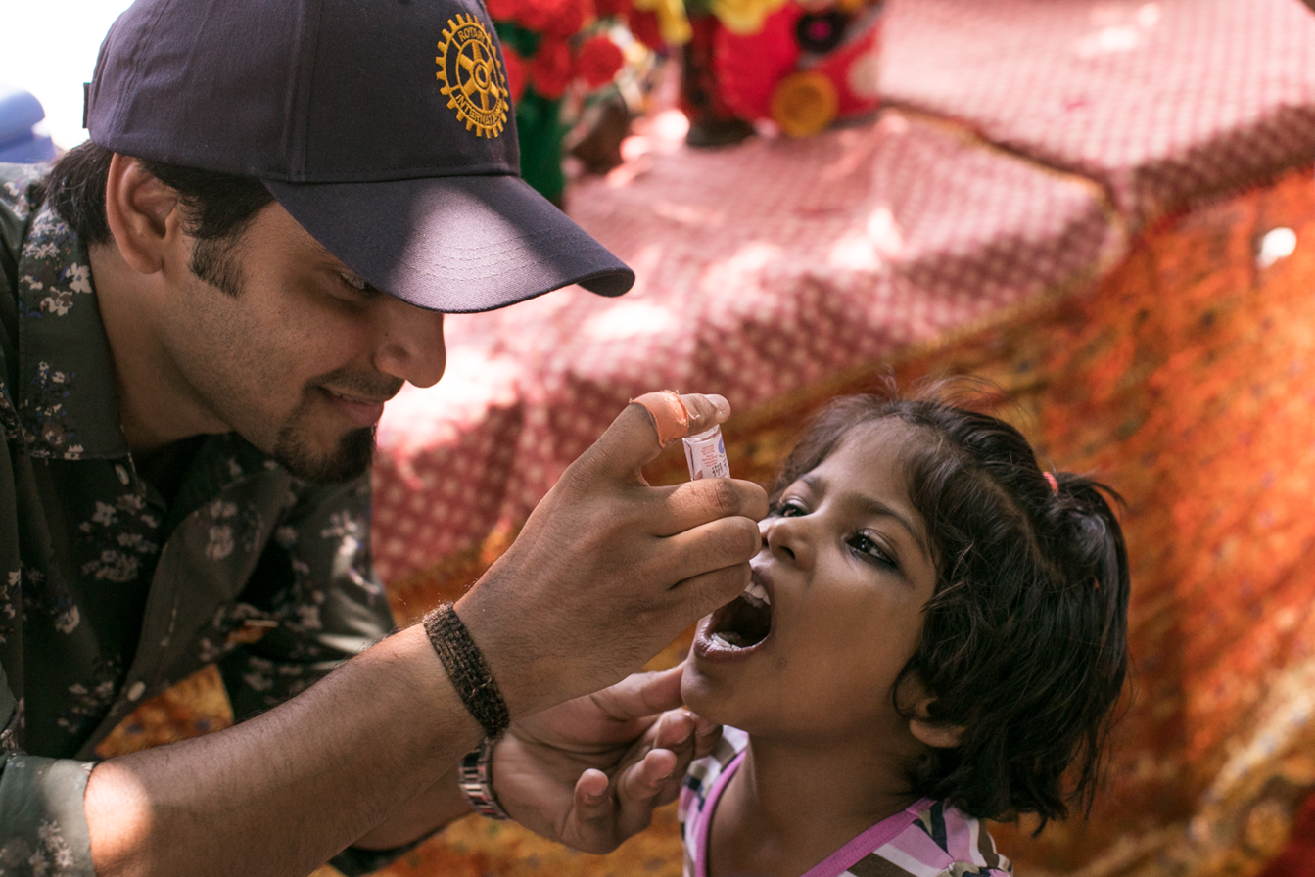
Public Image of Rotary
The most efficient and effective way to promote Rotary and its transformative work is through the telling of your Club’s human-interest stories.
Campaigns are prohibitively expensive and are shown to only have a short-term impact.
Social media can reinforce and increase the impact of your stories and events

Slide 7
Public Image of Rotary
Clubs are encouraged to share their stories through various channels, including:
Local media: Submit articles and press releases to newspapers, magazines, and online publications.
Social media: Share stories and photos on Facebook, Instagram, Twitter, and other platforms.
Rotary websites and newsletters: Feature stories on club and district websites and in newsletters.
Club brochures: Exciting photos, limited text, show people in action

Slide 8
Improving your chances of getting an article published
Journalists are time-poor and are more likely to publish your story if you do the majority of the work for them!
Max one page
Focus on human-interest stories that showcase the impact of Rotary on individuals and communities.
Provide high-quality photos and videos that capture the essence of your projects. Avoid groups looking at the camera.
Use social media to amplify your reach and engage with a wider audience.
Collaborate with other clubs and districts to share stories and resources.
Provide follow-up links for anyone interested in learning more or assisting
Provide a succinct summary of what Rotary is and what it does

Slide 9
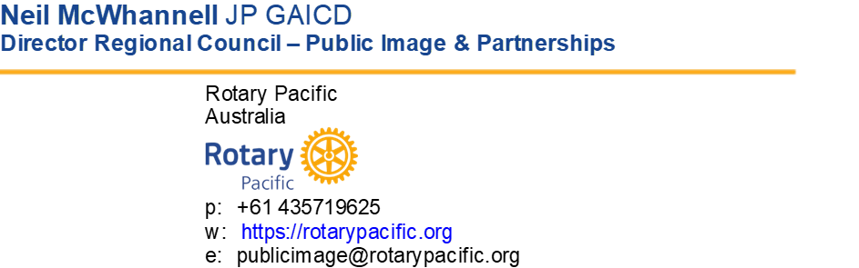
Resources
Copy of this presentation
Copy of Strategic Planning template
Specialist hub
Online resources:
https://brandcenter.rotary.org/en-us/search?q=public+image+presentation&tab=0&tt_lang=EN&dt_lang=EN
  Email me to discuss issues and ideas – publicimage@rotarypacific.org

