Slide 1


Slide 2
WE HAVE AN UNHEALTHY OBSESSION WITH MEETINGS

Slide 3








8 Key Elements of Cultural Transformation for Rotary in Zone 8
From a Male Culture to a Unisex Culture | From an Exclusive Culture to an Inclusive Culture
From a Covert Culture to an Overt Culture | From a Rigid Culture to a Flexible Culture
From a Culture of Member Attendance to a Culture of Member Engagement | From a Culture of Business Leaders to a Culture of Business & Community Leaders
From a Formal Culture to an Informal Culture | From a Meeting Centric Culture to a Service Centric Culture
Notes:
Those of you who know me well would recognise this as one of my great Rotary chestnuts. I personally believe this is the greatest transformation we need to implement if we are to increase Rotary’s relevance in the future. We desperately need to transform from a meeting centric culture to a service centric culture. This is a transformational journey that only relatively few clubs have started. After all, our motto is SERVICE above self. And SERVICE is one of our 5 core values.

Slide 4


Slide 5

How much spare time will they have?

Slide 6


Slide 7


Slide 8


Slide 9
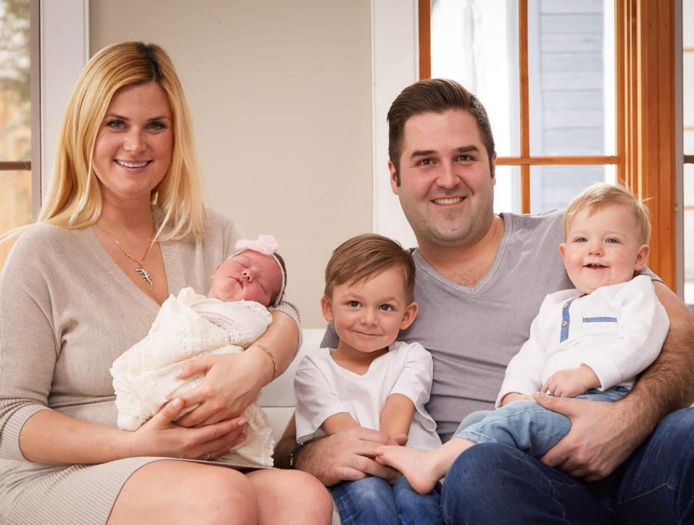

Slide 10



Slide 11


Slide 12
Think about the total time you
commit to Rotary in a year…
EVERYTHING
ELSE
MEETINGS

Slide 13

Questions we occasionally ask ourselves about our meetings.
Are our meetings interesting?
Are our meetings welcoming?
Are our meetings punctual?
Are our meetings run professionally?
Are our guest speakers informative?
Are our meetings good value?
Is the food and service good at our meeting venue?

Slide 14

The ONE question we NEVER ask about meetings but desperately need to...
Are our meetings a productive and effective use of our
volunteers’ time?

Slide 15

Busy people don’t have a lot of time to give, so the time they give must be effective and productive.

Slide 16


What do we want from our meetings?
Entertainment
Over 50s
Camaraderie
Productivity
Under 50s
Networking

Slide 17
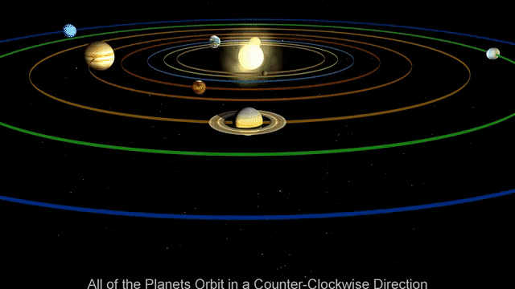
Service
Meetings
The Rotary Universe

Slide 18
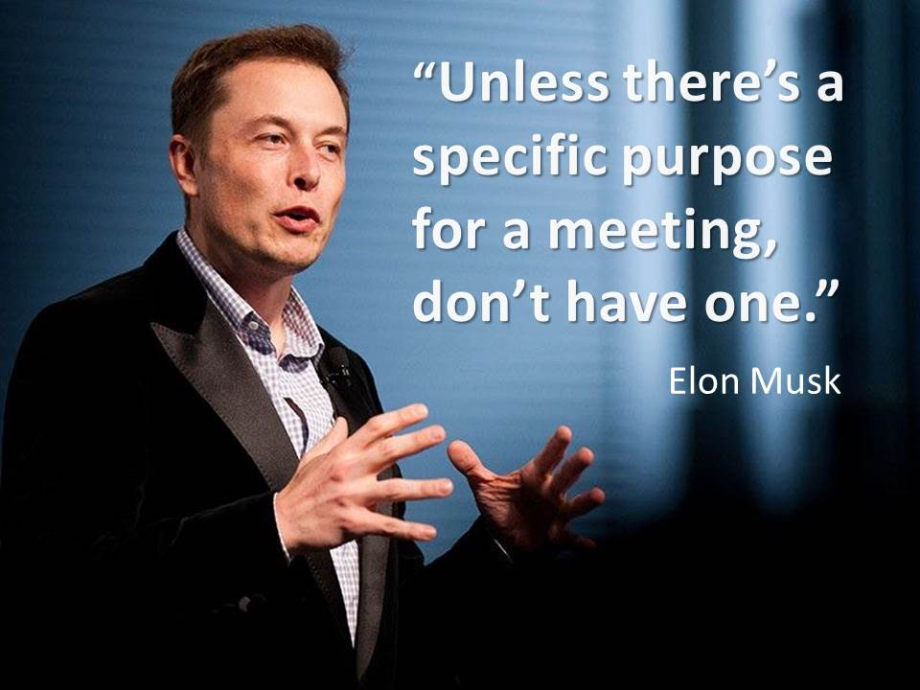

Slide 19



A quick test…
How meeting centric is your mindset?
Tell me about your club.
You cannot mention meetings.
If you don’t mention sausage sizzles!

Slide 20

Hey, this is Bob
and he’s interested in Rotary!
Great! When can you come to a meeting?
Wait… What?

Slide 21
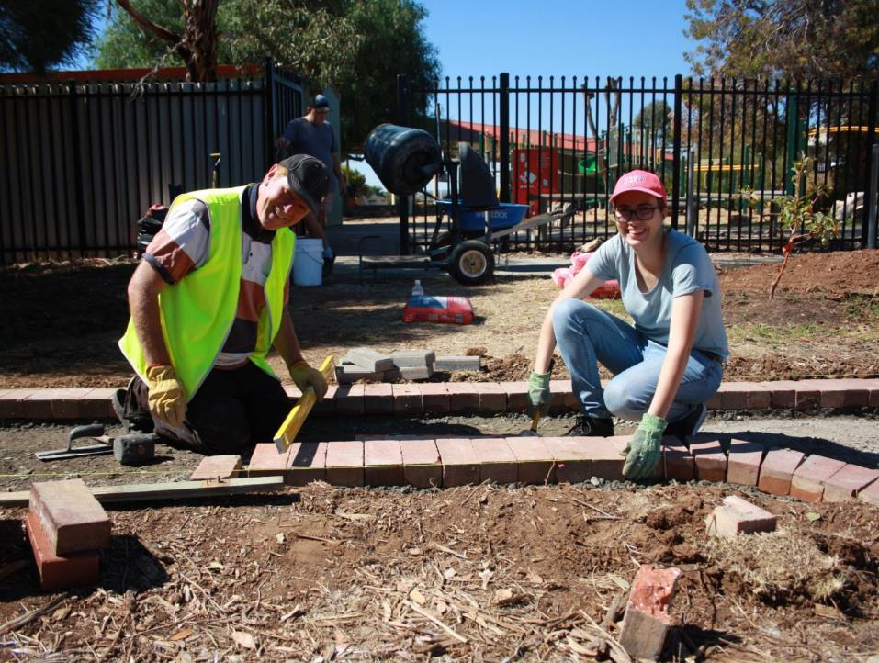
Daughter of
a Rotarian
Partner of
a Rotarian
Son of
a Rotarian

Slide 22
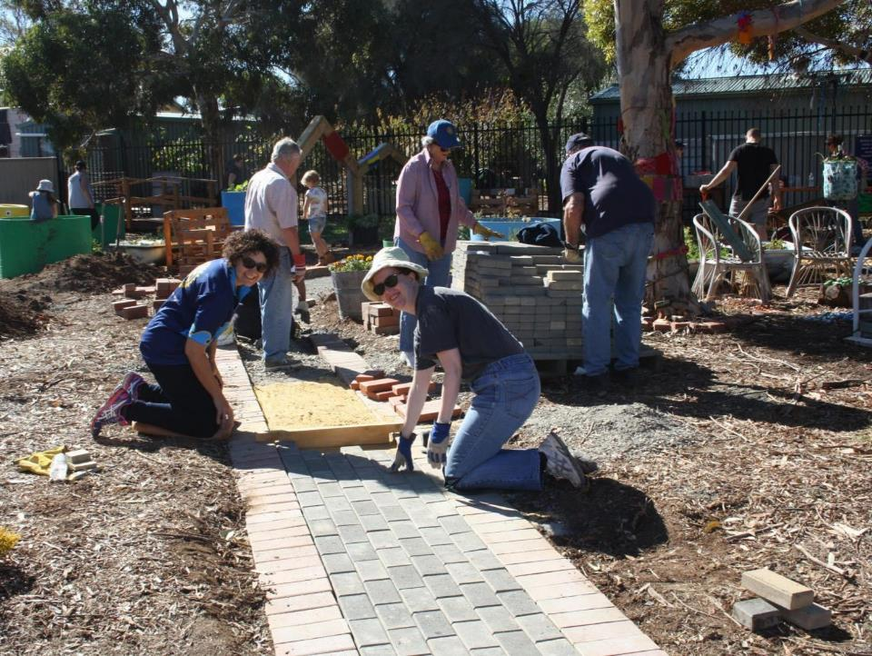
Neighbour of
a Rotarian
Wife of
a Rotarian

Slide 23
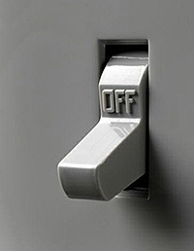
The vast majority of turn-offs for Rotary are bound up in our meeting-centric culture.
Wasted time
Cost of meals
Poor quality food
Inadequate dietary options
Uninviting venues
Noise from other diners
Boring speakers
Embarrassing rituals
People sitting in cliques
Poor punctuality/not sticking to an agenda
Poor access/car parking/security
Hard to get to on time for busy working people
Expectation of regular attendance

Slide 24
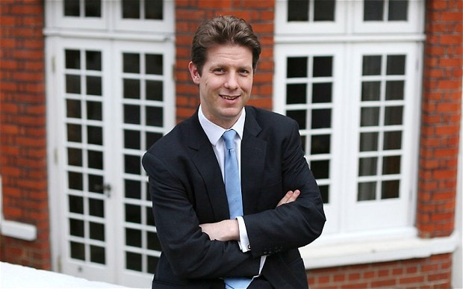
“What were we thinking?”
Fraser Nelson, British Journalist & Editor, Spectator Magazine.

Slide 25

Getting your message out.

Slide 26
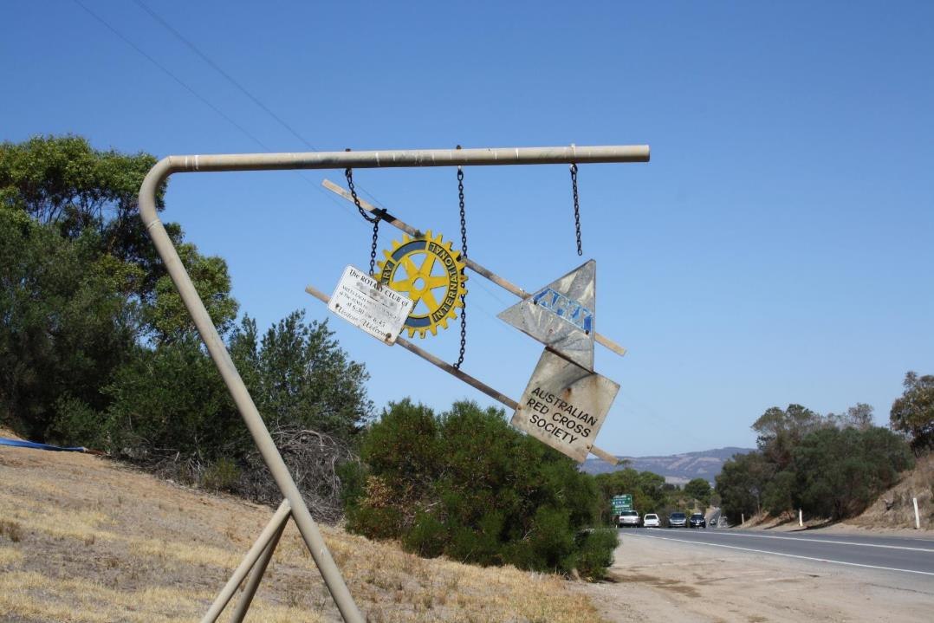

Slide 27


Slide 28
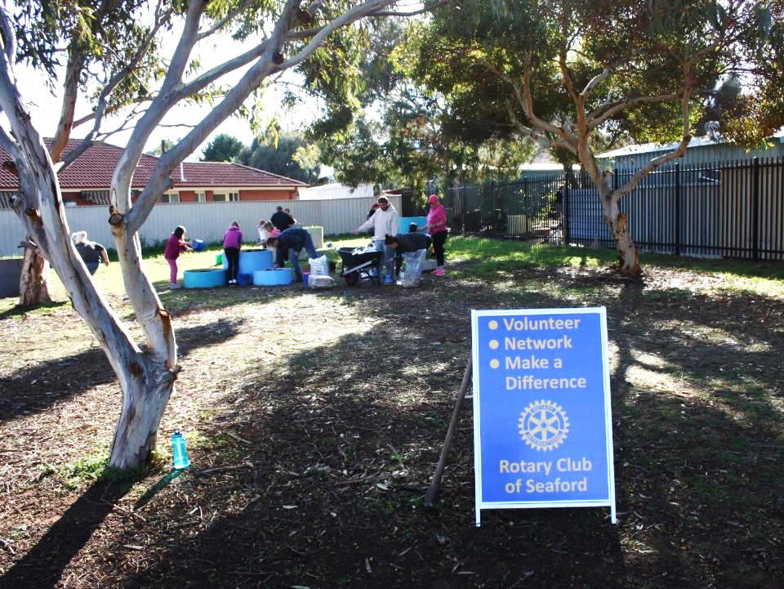


Slide 29


Slide 30


Slide 31
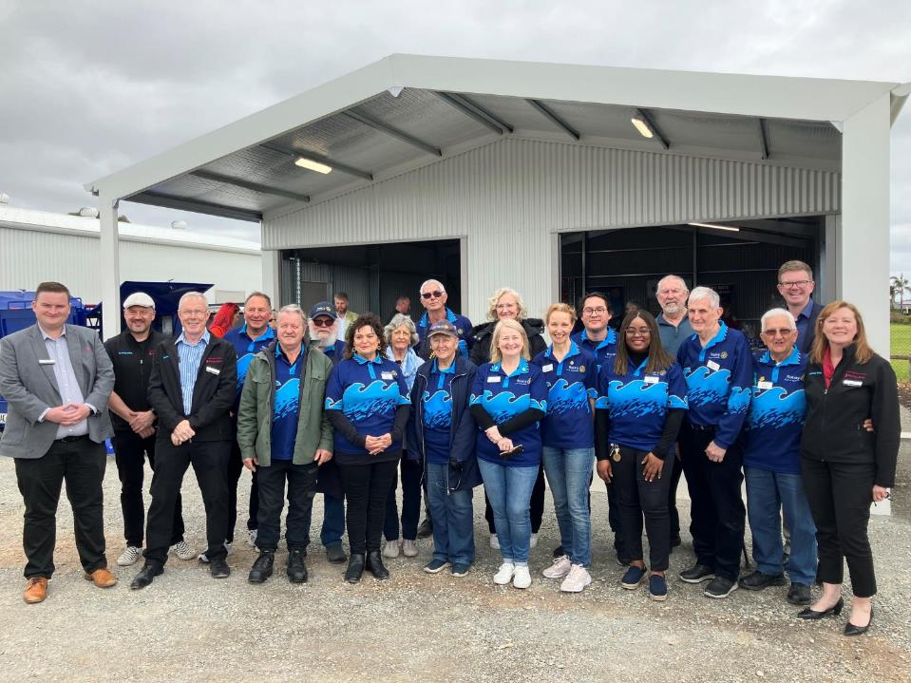
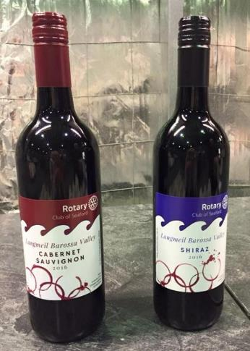

Slide 32
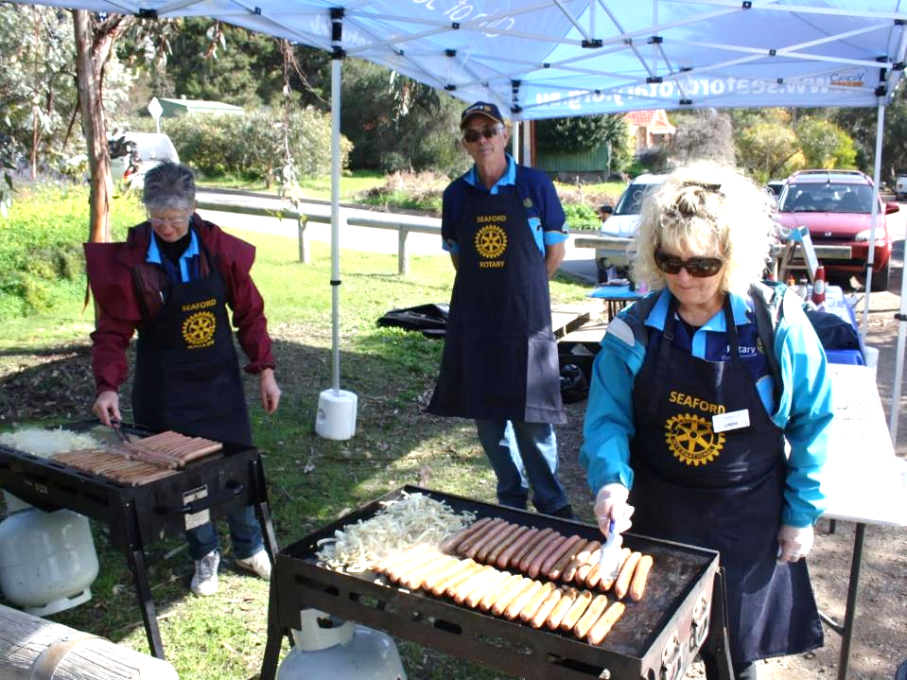

Slide 33
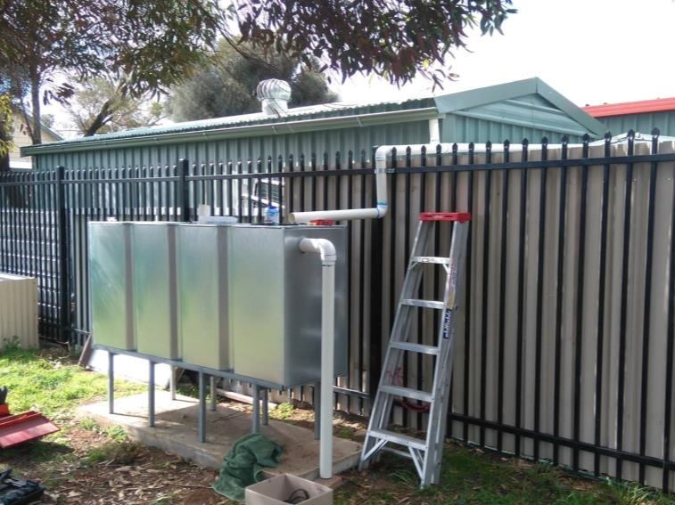

Slide 34
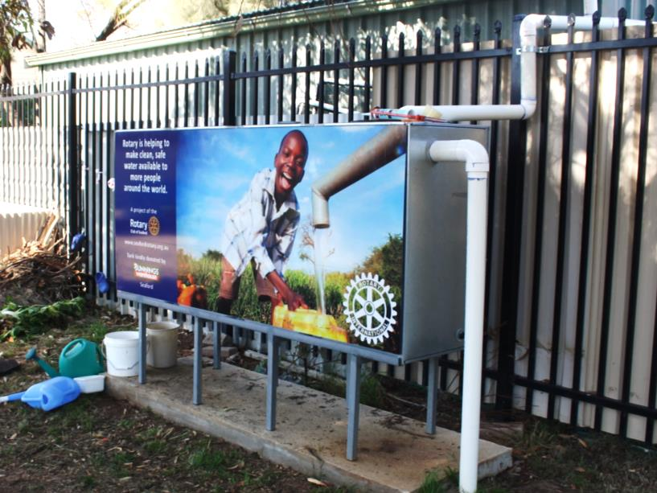


Slide 35


Slide 36

Presentation Folders

Slide 37


Slide 38
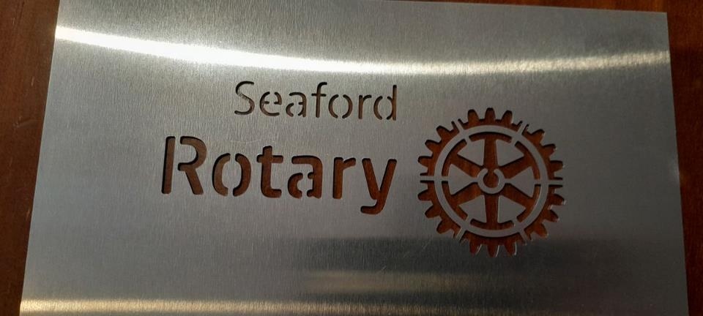

Slide 39
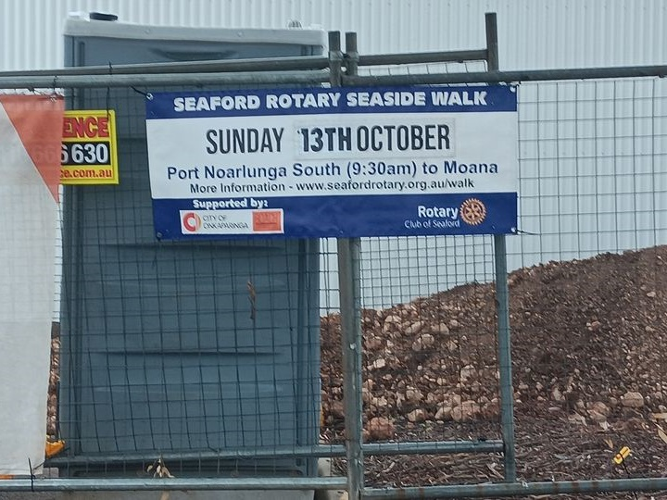

Slide 40


Slide 41
I
HATE
BIG
CHEQUES

Slide 42
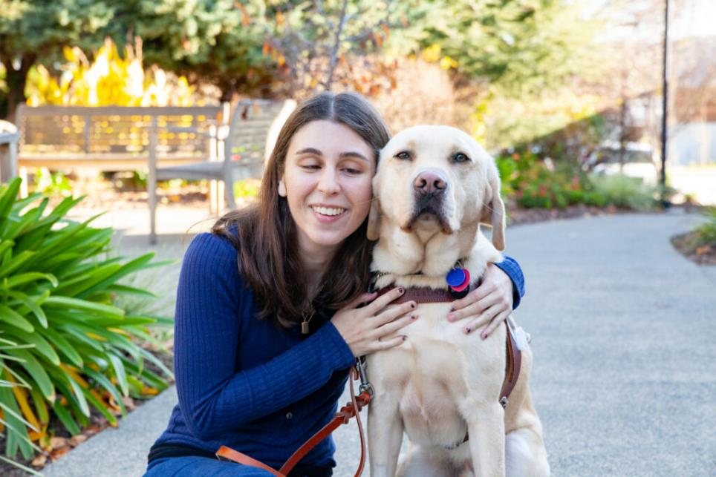

Slide 43
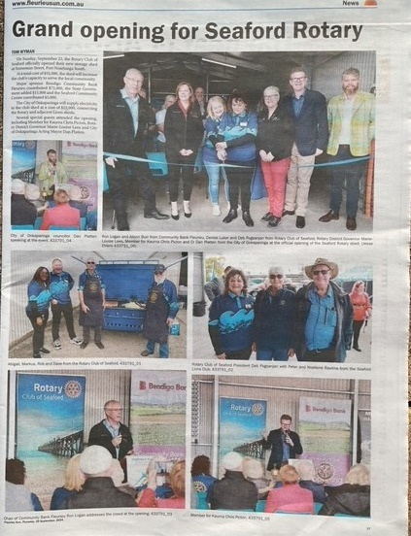

Slide 44
Any publicity is NOT
good publicity!

Slide 45
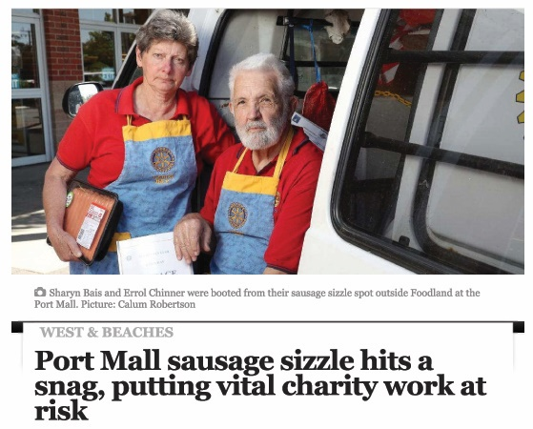

Slide 46

Are you in love with your
Club Website?

Slide 47
A quick test…
How effective is your website?
1. Give your phone/laptop/tablet to a friend or family member.
2. Ask them to find your club website WITHOUT giving them the URL (www.seafordrotary.org.au) See how long this takes.
3. Ask them to find out...
Club priorities
How to get involved
Who to contact
What’s in it for them
If they cannot EASILY find this stuff out, your website failed the test.

Slide 48
The primary target for your website is
non-Rotarians.
Your website’s landing page is VALUABLE REAL ESTATE.
Don’t fill that valuable real estate with stuff for your own members.
Don’t have a “Become a Member” or a
“Join our Club” button.
Instead use a “Volunteer” button.

Slide 49
Are you in love with your
Club Website?

Slide 50
I’m about to let you in on the best website deal you will ever hear…
Graham Fussen
+61 412 694 461

Slide 51

1. Get the PRODUCT right.
2. Tell the world about it.

