Slide 1

Our Club – Our Plan
2024 – 2028 Strategic Plan

Slide 2
Why
Numbers are declining in the Western world
50% of new members are no longer members after 2 years
50 Clubs in our Zone have handed in their Charters in the past year
We are not alone: Churches, Associations, Masonic Lodges, Scouts - all declining
People are still looking to engage in the Community but in new ways – so we must adapt

Slide 3
Pre-meeting homework
Invite all Club Members to reflect on the Club’s Strengths, Weaknesses, Opportunities and Threats. List 3 items for each. Collate and present to the meeting.
Ask members to reflect on what the Club’s Value Proposition is for prospective members:
By joining our Club you will …..

Slide 4

Agenda
Where we are now
Where we want to be?
Projects
Meetings – format etc
Assistance on offer
Ideas

Slide 5
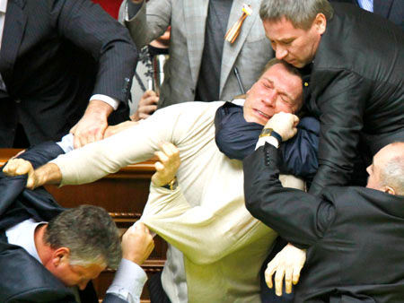
Rules
Positive, constructive contributions
Avoid making statements
Never make things personal

Slide 6

Strategic Planning

Slide 7
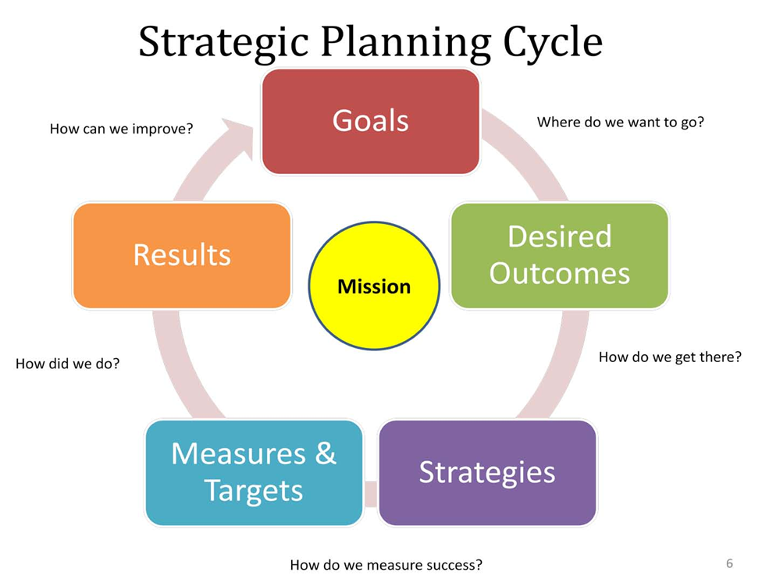
Strategic Planning

Slide 8

Membership
Current state of Play
Provide details of current membership:
Number of members
Gender of members
Average Age of members
How many regularly attend meetings
How many are active in Club projects

Slide 9
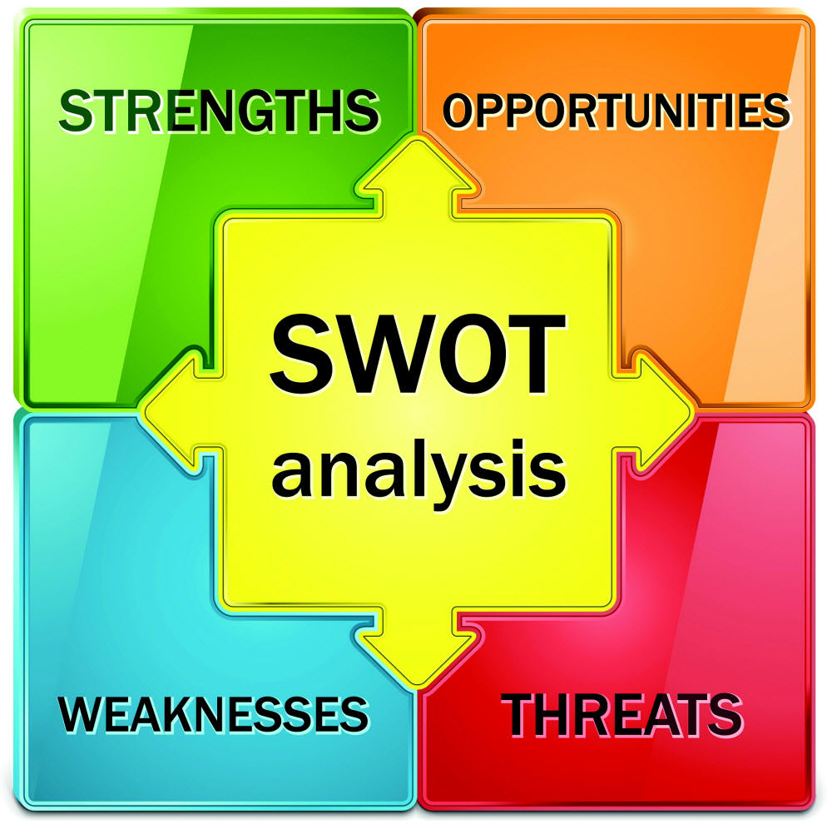
SWOT
Here are the top things you identified.

Slide 10
SWOT
Strengths
Friendly, welcoming club
Strong membership
High level of activity and projects
Strong financial position
Strong Committee and Board
Very good gender mix
Diversity of membership
Breakfast meeting format

Slide 11
SWOT
Weaknesses – sample responses shown
Risk of member burnout through too many projects
Average Age of members is high
Not engaging enough with younger people
Not selling ourselves well enough
Public awareness of activities is not high
Not enough ‘fun’ activities
We keep doing the same things
Resistance to change
Failure to evaluate why we do things and their success
Succession planning
Rituals etc
Failure to engage with local Asian communities
Not enough younger members prepared to step up for leadership roles

Slide 12
SWOT
Opportunities
Financially advantaged community
Many people are willing to give back
Ensure greater public awareness of Rotary and its work
Utilise volunteers more
Work in partnerships – other clubs etc
Re-engage with local businesses
Develop Community projects to involve the public
Ensure speaker program is exciting and engaging
Develop a fresh approach
Take advantage of the many grants that are available
Involve spouses, partners and lovers
Utilise our alumni – many in Probus
Get into schools to sow seeds
Greater use of social media to promote our work
Tell and share our compelling stories
Allow time for members to share their ideas for new and exciting events and projects
Corporate Membership

Slide 13
SWOT
Threats
Membership loss
Ageing membership
Lack of engagement
Leaving the heavy lifting to a few
Too many projects
Other clubs
Member burn out
Complacency – no new ideas
Failure to develop succession planning
If we have fewer active members we should consciously do less (avoid being overstretched and reduce quality).
Lack of peer support/mentoring for all of our members
Less major fundraising opportunities

Slide 14
Value Proposition
What are we offering new members?
Make a Meaningful Impact: Contribute to impactful local and international service projects that address pressing community needs and global challenges.
Build Lasting Connections: Network with a diverse group of professionals and community leaders, fostering friendships and professional relationships that enrich your personal and professional life.
Develop Leadership Skills: Enhance your leadership and organizational abilities through active participation in club initiatives, committees, and events.
Experience Personal Growth: Engage in opportunities that promote personal development, cultural awareness, and a deeper understanding of global issues.
Enjoy Fellowship and Camaraderie: Participate in regular meetings, social events, and collaborative projects that offer a sense of community and belonging.
Be Part of a Global Movement: Join a worldwide network of Rotary members dedicated to promoting peace, fighting disease, providing clean water, supporting education, and growing local economies.
By becoming a member, you’ll not only contribute to meaningful causes but also enrich your own life through service, learning, and connection with like-minded individuals committed to making a positive difference.

Slide 15
Value Proposition
What are we offering new members?
In reality it looks like…
For $375 a year, I get to go to formal meetings with a bunch of old people.
In addition, I pay $30 for a breakfast (over $1000 a year)
Coming to our meetings is confronting for younger people
This is not exciting new members
Within 2 yrs 50% of new members are lost to Rotary

Slide 16
Attracting new members
  Prospective members are looking for:
  An opportunity to give back and serve
  To be part of the Community
  Quality leadership in play
  Efficient and effective practices that value their time
  They will not be attracted to:
  Inefficiencies
  Poor leadership
  Acrimony or internal politics
Success breeds success!

Slide 17

What do we want our club to look like in 5 years?

Slide 18
Membership
Questions: Do we try to alter who and what we are just to cater for the young?
Will they come? Will it interest them? Will they participate? Do they have time to give back when they have young families and developing careers?
Do we need/require all members to actively participate in projects? If so, we will lose some
Do we want to be any larger? Is chasing new members what we want? If so – how should we do it?
How should we promote ourselves?

Slide 19
Assistance on Offer
Regional Council – developing strategies and resources
Rotary Specialists
Rotary Community Leaders & Groups
Club Training – Fit for Purpose 2 day program

Slide 20
Rotary International - Action Plan
Increase our IMPACT – develop service projects that reflect the needs of our community and are more effective.
Expand our REACH – work with groups, organisations, and community leaders that we haven’t partnered with before.
Enhance participant ENGAGEMENT – make all members feel like they have a role in the club and make sure that anyone who engages with our club feels empowered to share their ideas and get involved.
Increase our ability to ADAPT – ask members what their club should continue, start, or even stop doing to ensure that the club reflects the needs of its members and potential members.

Slide 21
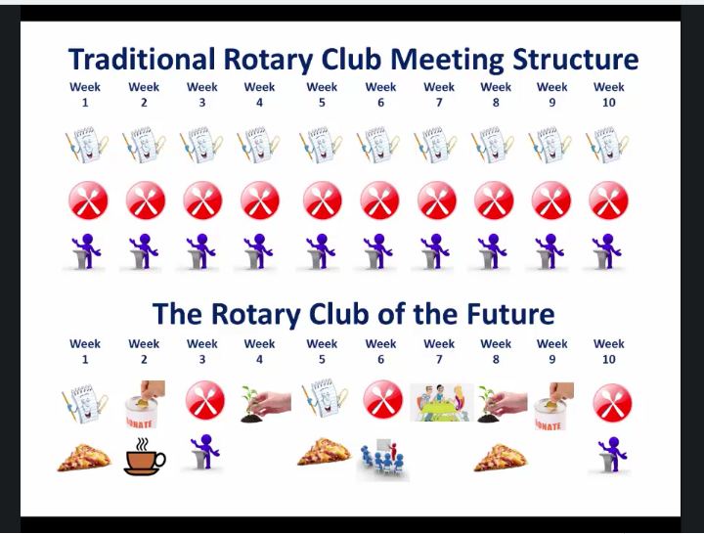
Meetings

Slide 22

Rituals
Regalia
Rotary Grace
Singing the National Anthem

Slide 23



Slide 24
Recommendations
Make sure everyone feels welcomed each week
Acknowledge members who have stepped up
Make sure members make visitors feel welcome
Make sure meetings and activities are fun!
Choose Rotary projects which engage members and enable them to make a real impact
Avoid raising funds for other charities
Avoid internal politics and acrimony!

Slide 25
Ideas
Mix up format of meetings
Visit and work more closely with other Clubs
Actively tell our human interest stories
Examine partnerships with other organisations
Actively work to engage the Asian community
Different Membership options
Utilise volunteers for events and follow up with invitations to meetings
Organise Information events as a way of sourcing new members

Slide 26

Fundraising
Events, Raffles, Partnerships, Membership fees, Donations, Grants, Bequests
Which provides the greatest return? Are they all worth the time and effort? Do we have the resources? Which is the smartest option?

Slide 27

Projects
List current projects. Are these sustainable? Which should we keep/drop? Which provides us with the greatest return. New ideas must have a champion prepared to lead and drive it.

